Slide 1
Multi-species Catalogues of Regulatory Elements: ENCODE
Session 2
T6: Making the most of cis-regulatory annotations for genome-scale analysis
Gabriela A. Merino
Senior Bioinformatician, Ensembl Regulation, EMBL-EBI
03/09/2026

Slide 2
Session map
1
The ENCODE Project
General description
Available datasets
1
The ENCODE Data Portal
Navigation
Accessing experimental data and metadata
Defining and accessing reference epigenome data
1
Hands-on
Coffee break
2
Registry of cCREs
cCREs definition and identification
Classification
Biosample classification
2
The SCREEN browser
Accessing cCREs
Accessing experimental data and metadata
2
Hands-on

Slide 3
1
ENCODE: Experimental data

Slide 4



Do not edit
How to change the design
Have you used ENCODE data?
Presenting with animations, GIFs or speaker notes? Enable our Chrome extension
Notes:
📣 This is Slido interaction slide, please don't delete it. ✅ Click on 'Present with Slido' and the poll will launch automatically when you get to this slide.

Slide 5
The ENCODE project
The Encyclopedia of DNA Elements (ENCODE) Consortium is an ongoing international collaboration of research groups launched on 2003.
It aims to build a comprehensive parts list of functional elements in the human and mouse genomes.
It maps genomic activity across tissues, cell types, developmental stages, and experimental conditions.
ENCODE data help interpret non-coding regions by connecting genomic coordinates to regulatory evidence such as chromatin accessibility, histone marks, transcription factor binding, RNA expression, methylation, and 3D chromatin structure.
By the end of 2024, it includes results from 23,000+ functional genomics experiments, 800+ functional elements characterization experiments and 60,000+ results from integrative computational analyses, available on an open-access data-portal.
Standardised data analysis pipelines
Standardised metadata

Slide 6
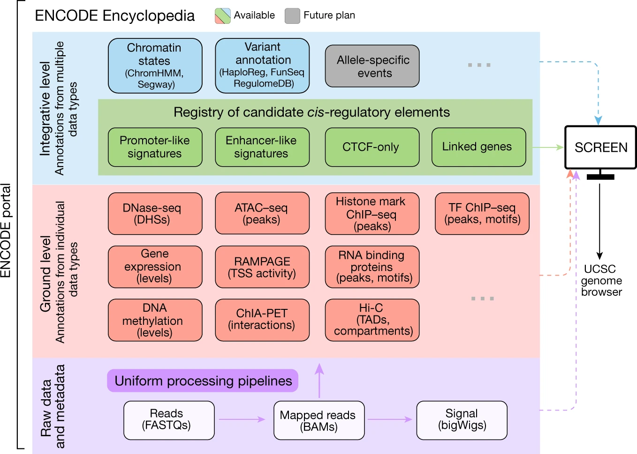
The ENCODE project and the ENCODE portal
Figure extracted from Expanded encyclopaedias of DNA elements in the human and mouse genomes¹
¹The ENCODE Project Consortium., Moore, J.E., Purcaro, M.J. et al. Expanded encyclopaedias of DNA elements in the human and mouse genomes. Nature 583, 699–710 (2020). https://doi.org/10.1038/s41586-020-2493-4

Slide 7
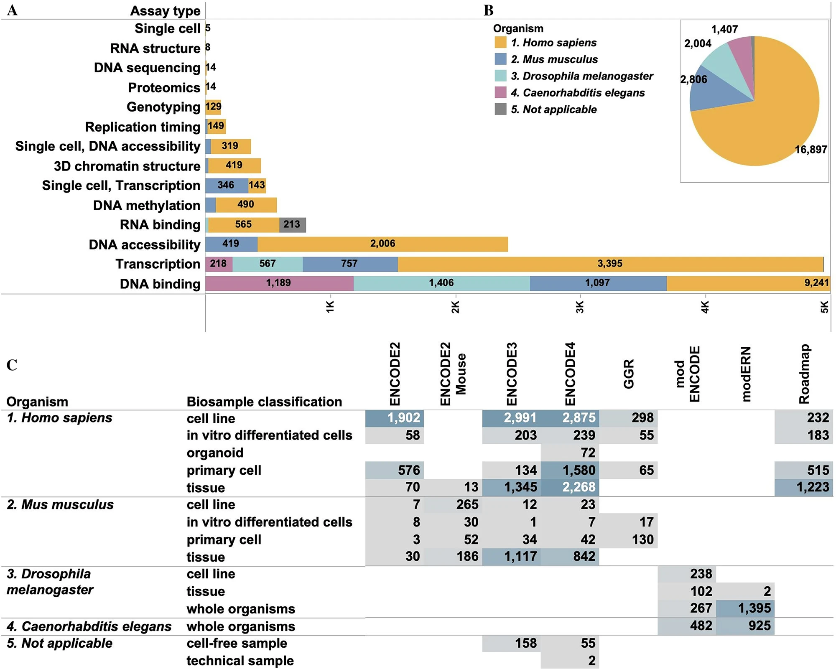
The ENCODE project and the ENCODE portal
Figure extracted from Data navigation on the ENCODE portal²
²Kagda, M.S., Lam, B., Litton, C. et al. Data navigation on the ENCODE portal. Nat Commun 16, 9592 (2025). https://doi.org/10.1038/s41467-025-64343-9

Slide 8
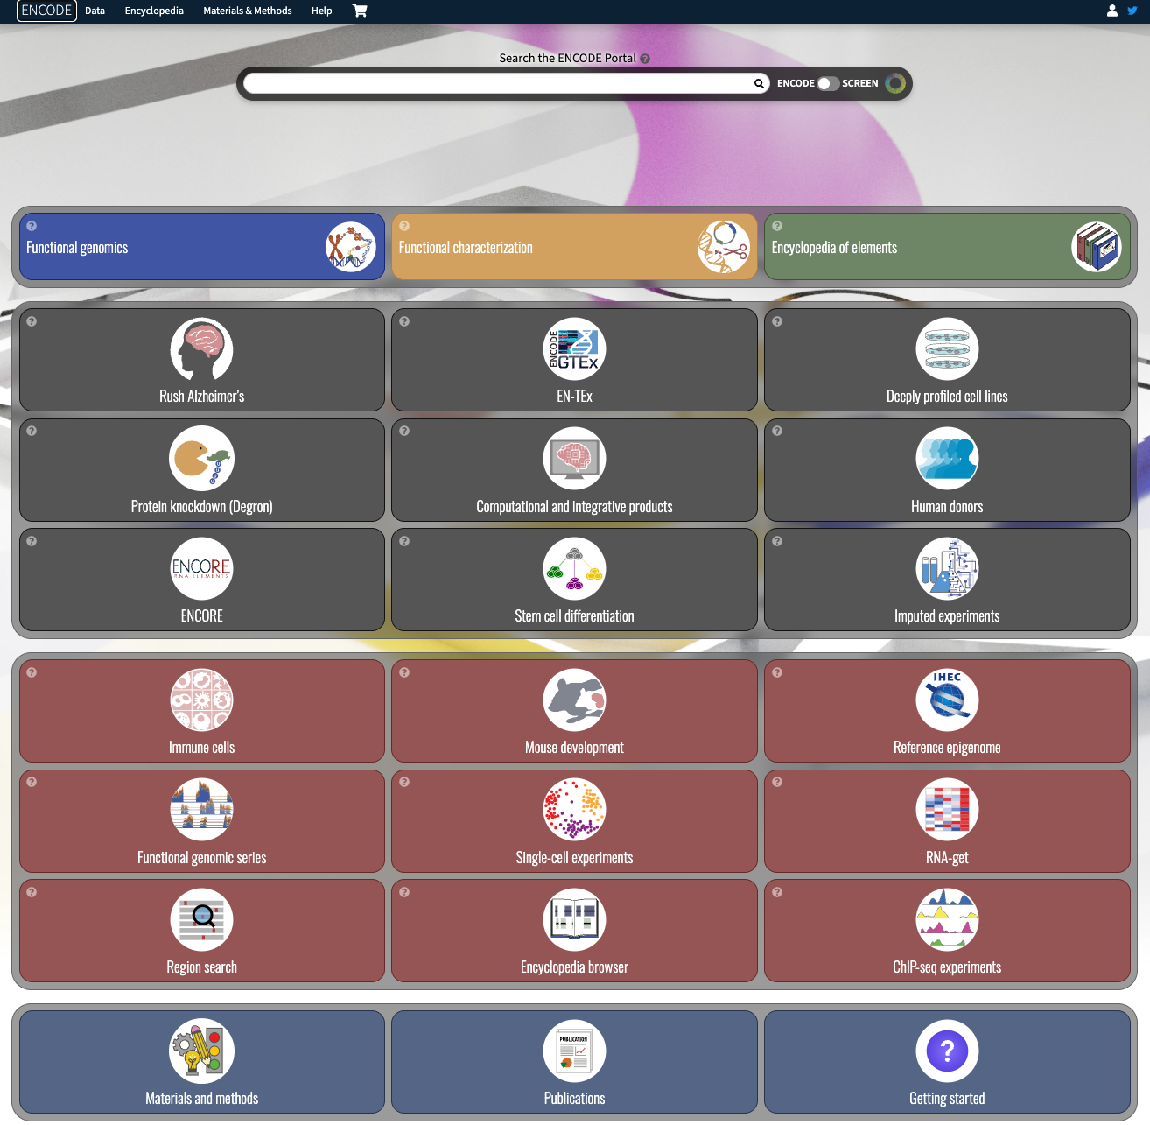
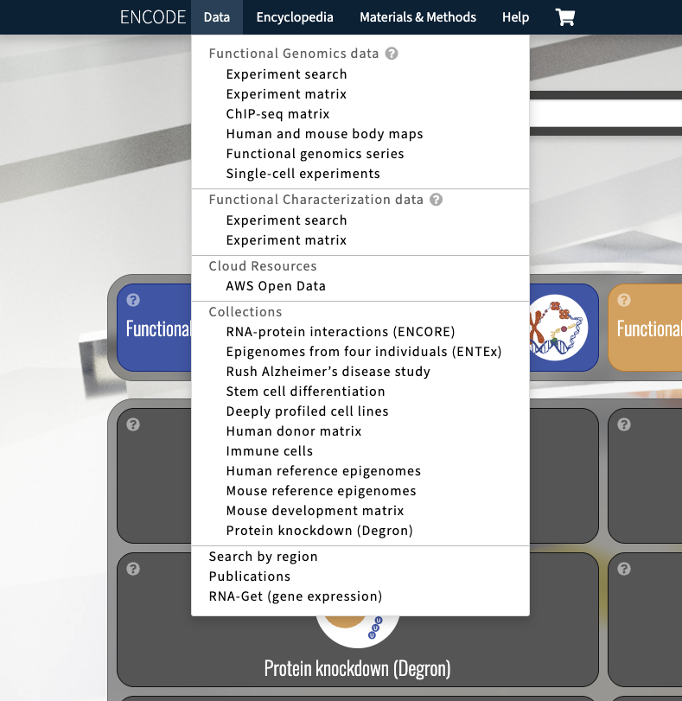

The ENCODE project and the ENCODE portal
https://www.encodeproject.org/

Slide 9

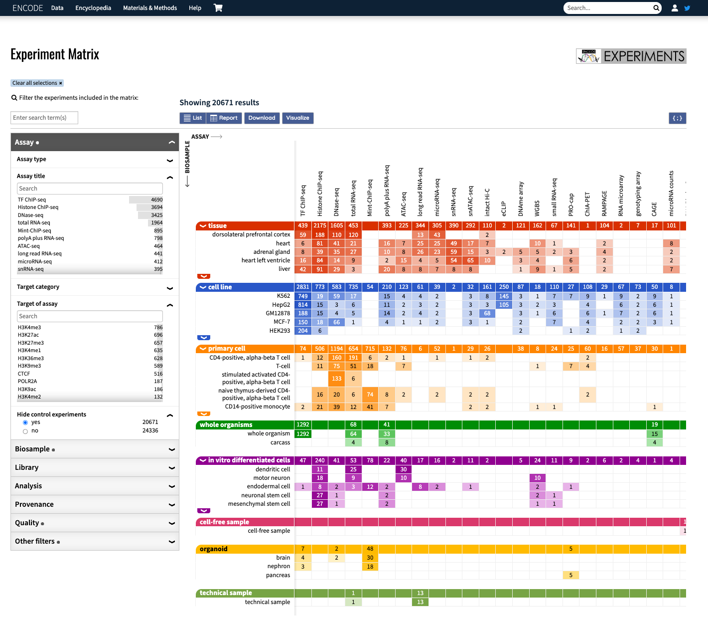
The ENCODE project and the ENCODE portal
Alternative views
Filtering sidebar
Available experiments

Slide 10

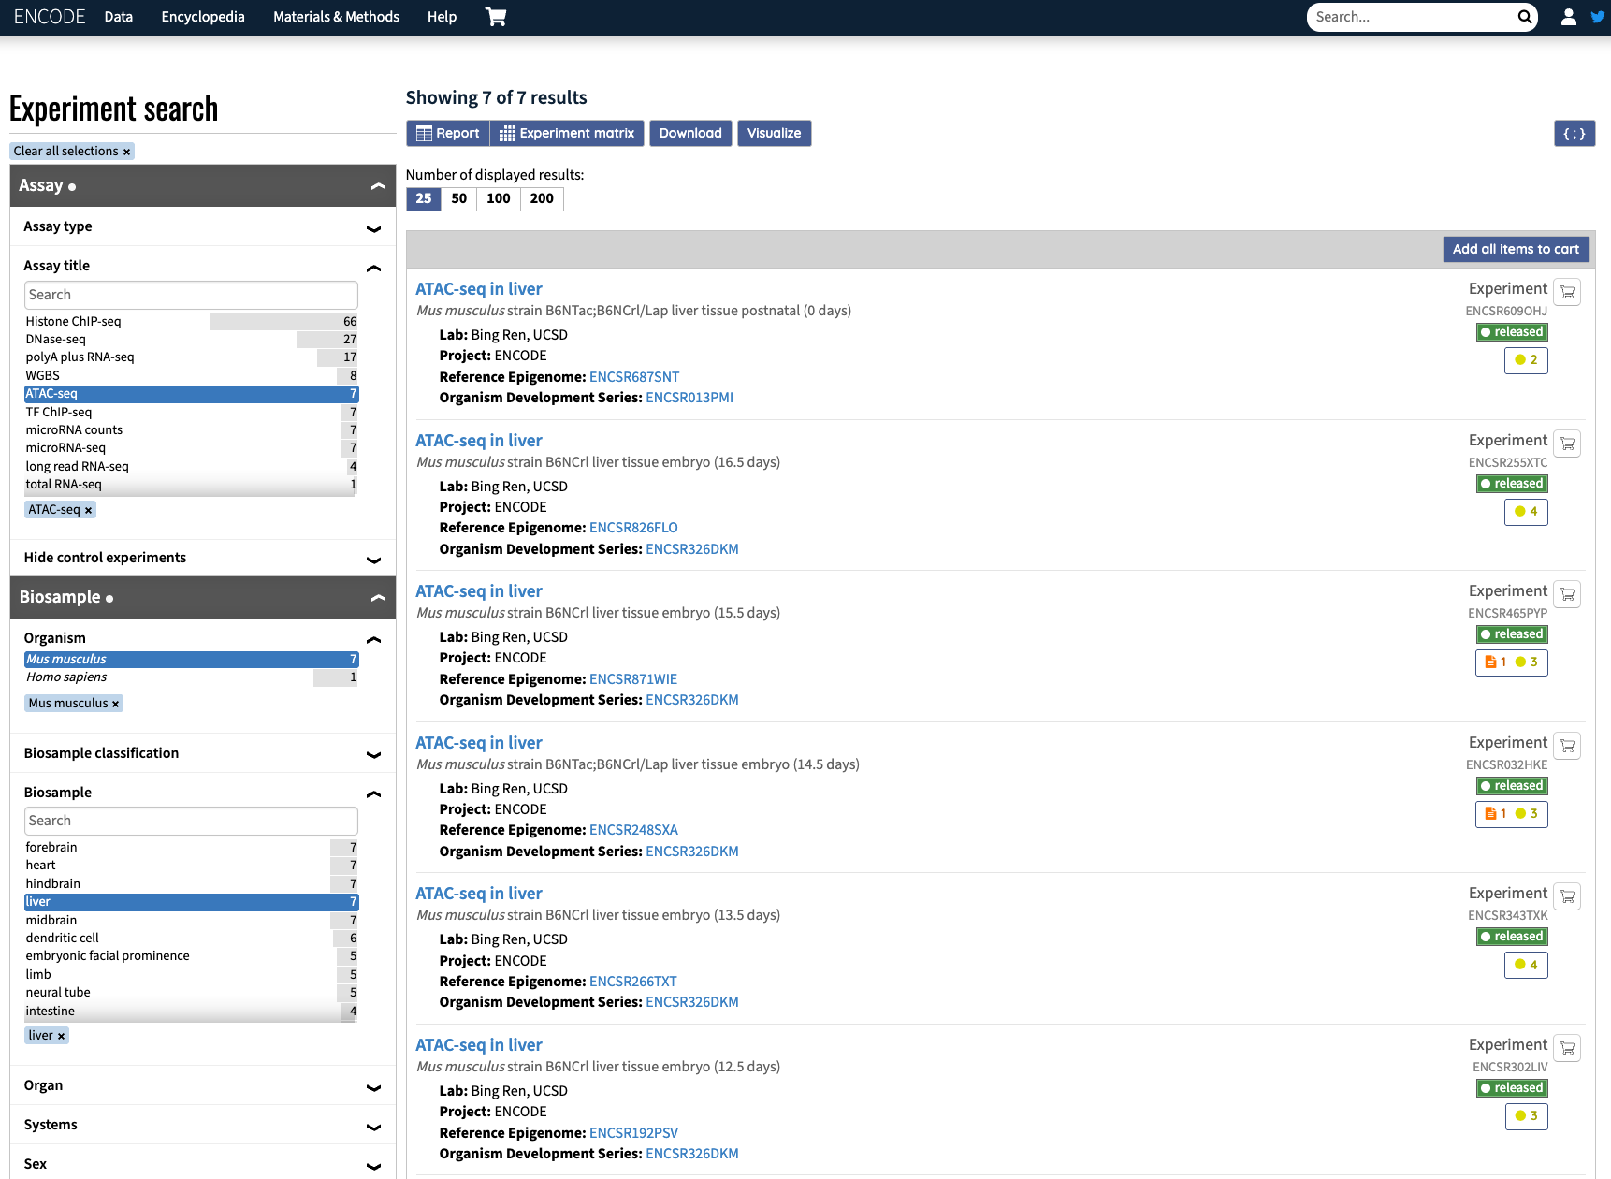
The ENCODE project and the ENCODE portal
Download
JSON
Status
ATAC-seq from mouse liver filters applied
Experiment
Audits

Slide 11

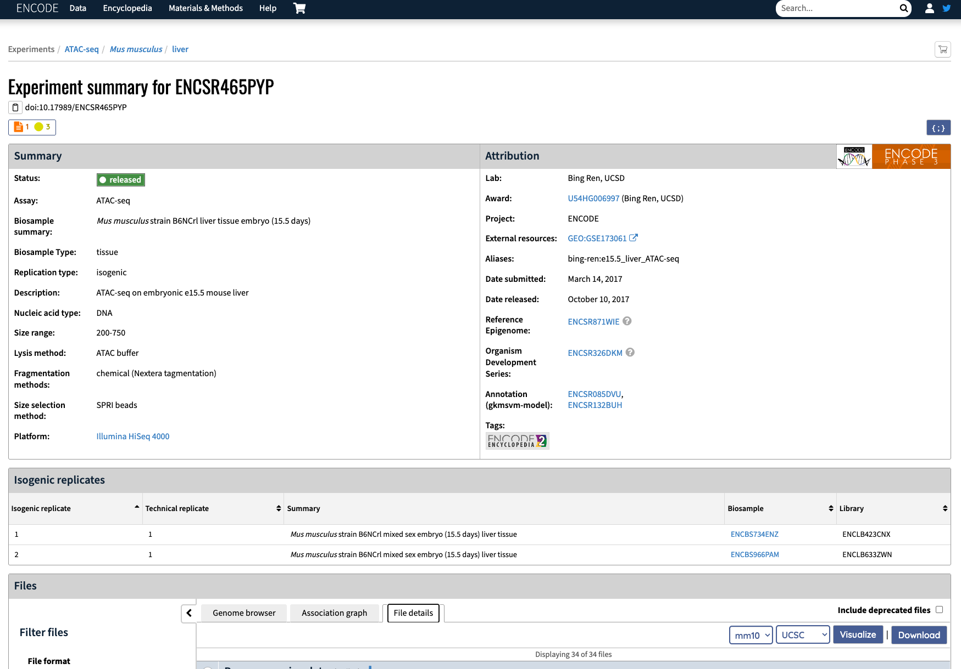
The ENCODE project and the ENCODE portal
Metadata
Replicates summary

Slide 12
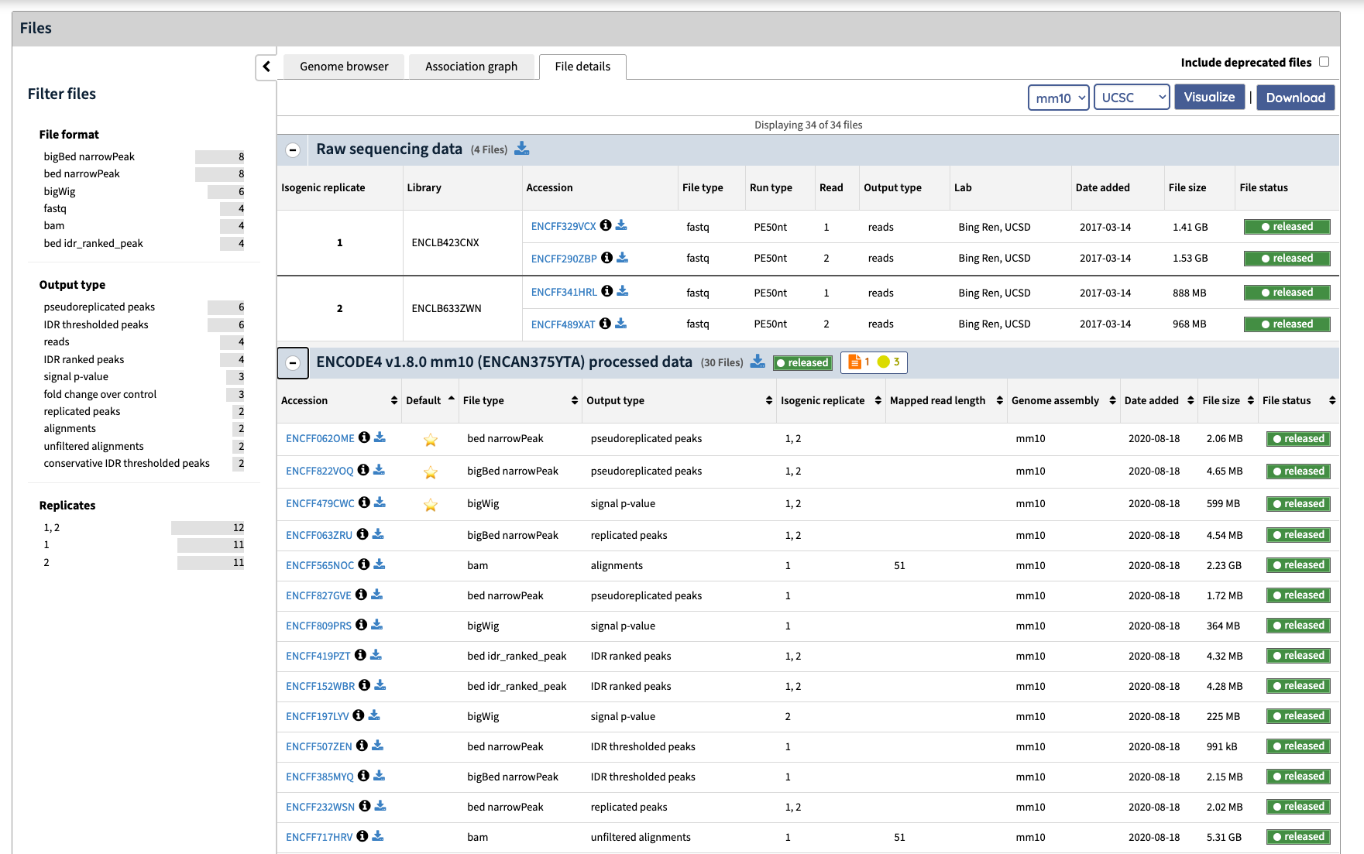
The ENCODE project and the ENCODE portal
Sidebar filtering
Raw files
Processed files

Slide 13
The ENCODE project and the ENCODE portal
Reference epigenomes: grouped data from a particular tissue, cell line, primary cell, in vitro differentiated cell biosamples organized following guidelines set out by IHEC (https://ihec-epigenomes.org/)

Slide 14

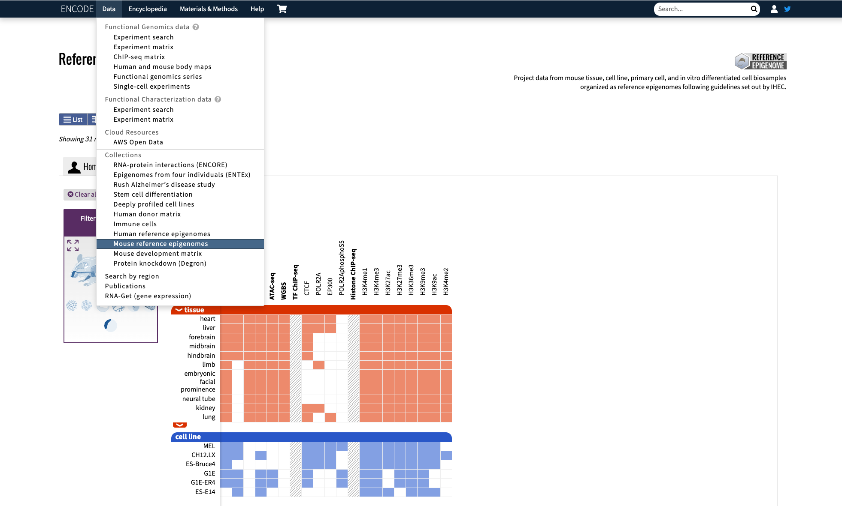
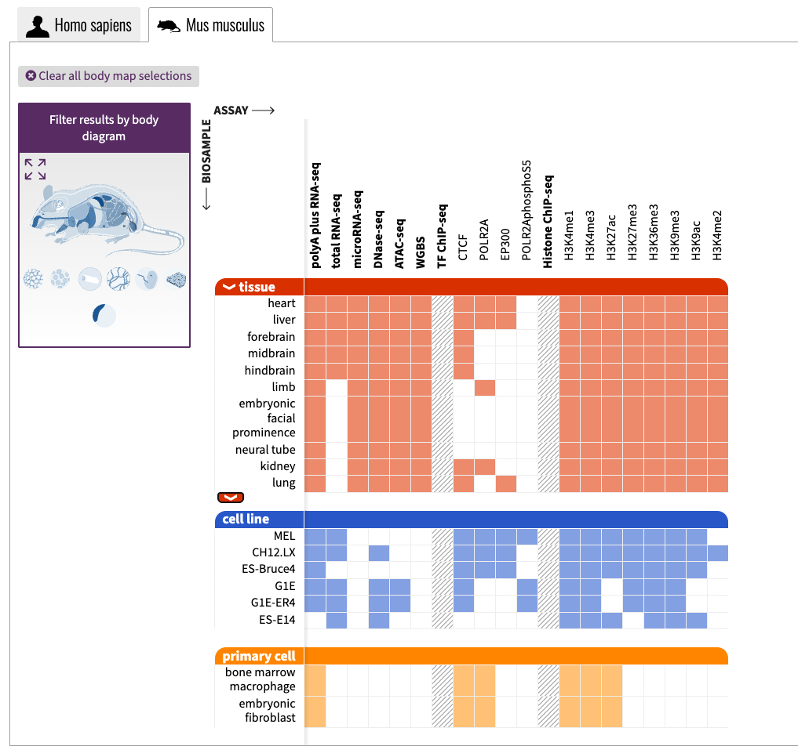
The ENCODE Reference Epigenomes

Slide 15

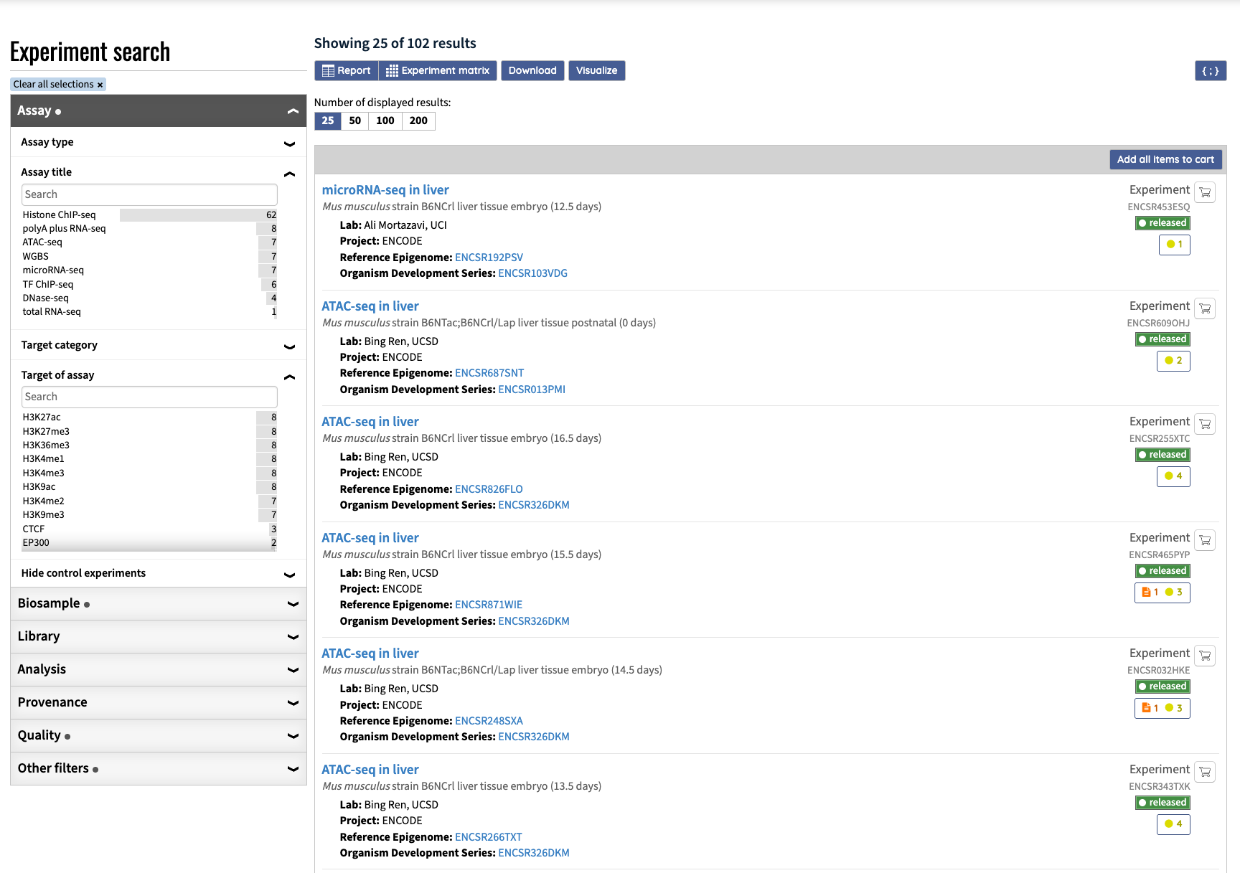
The ENCODE Reference Epigenomes

Slide 16

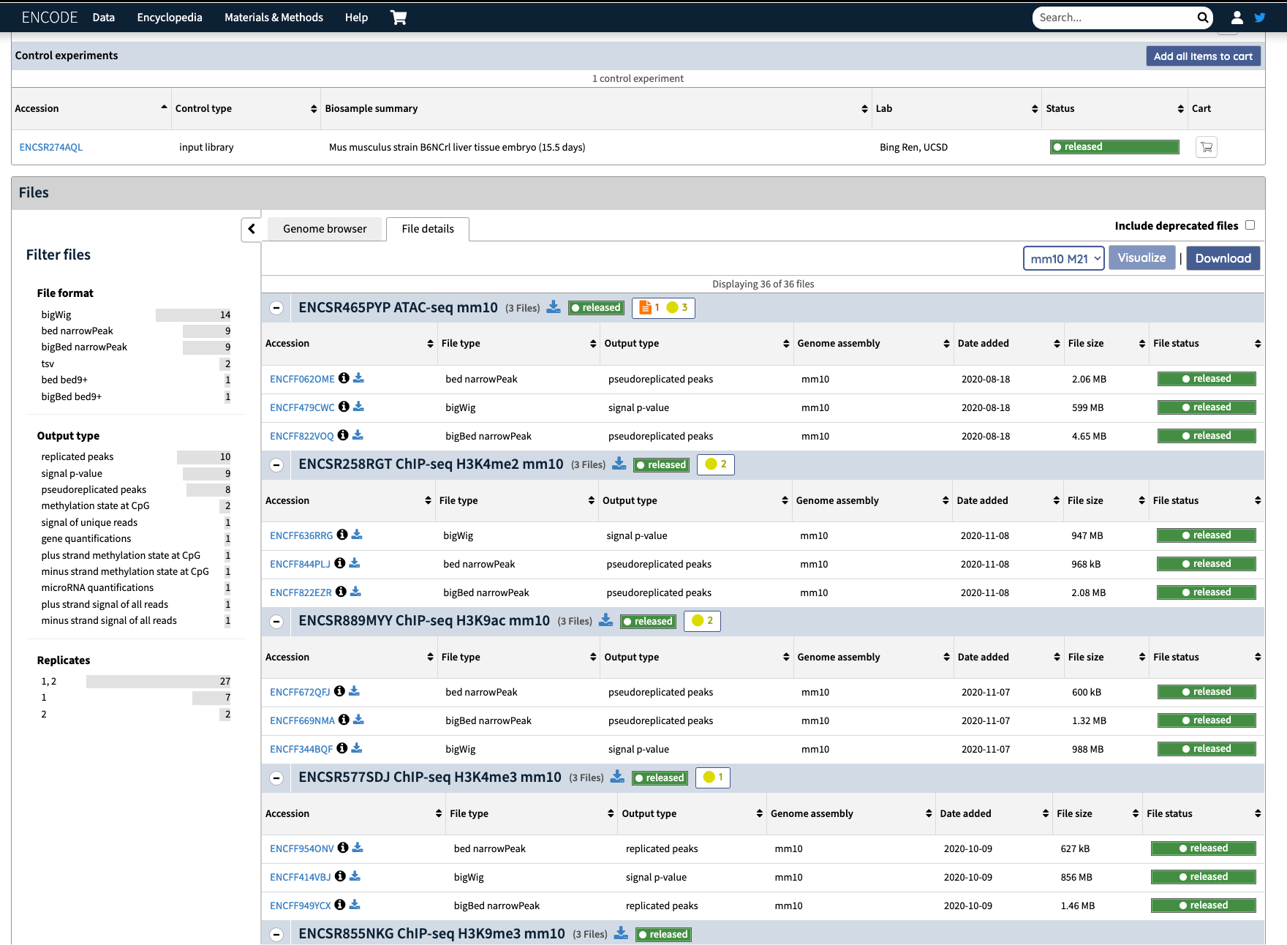
The ENCODE Reference Epigenomes

Slide 17
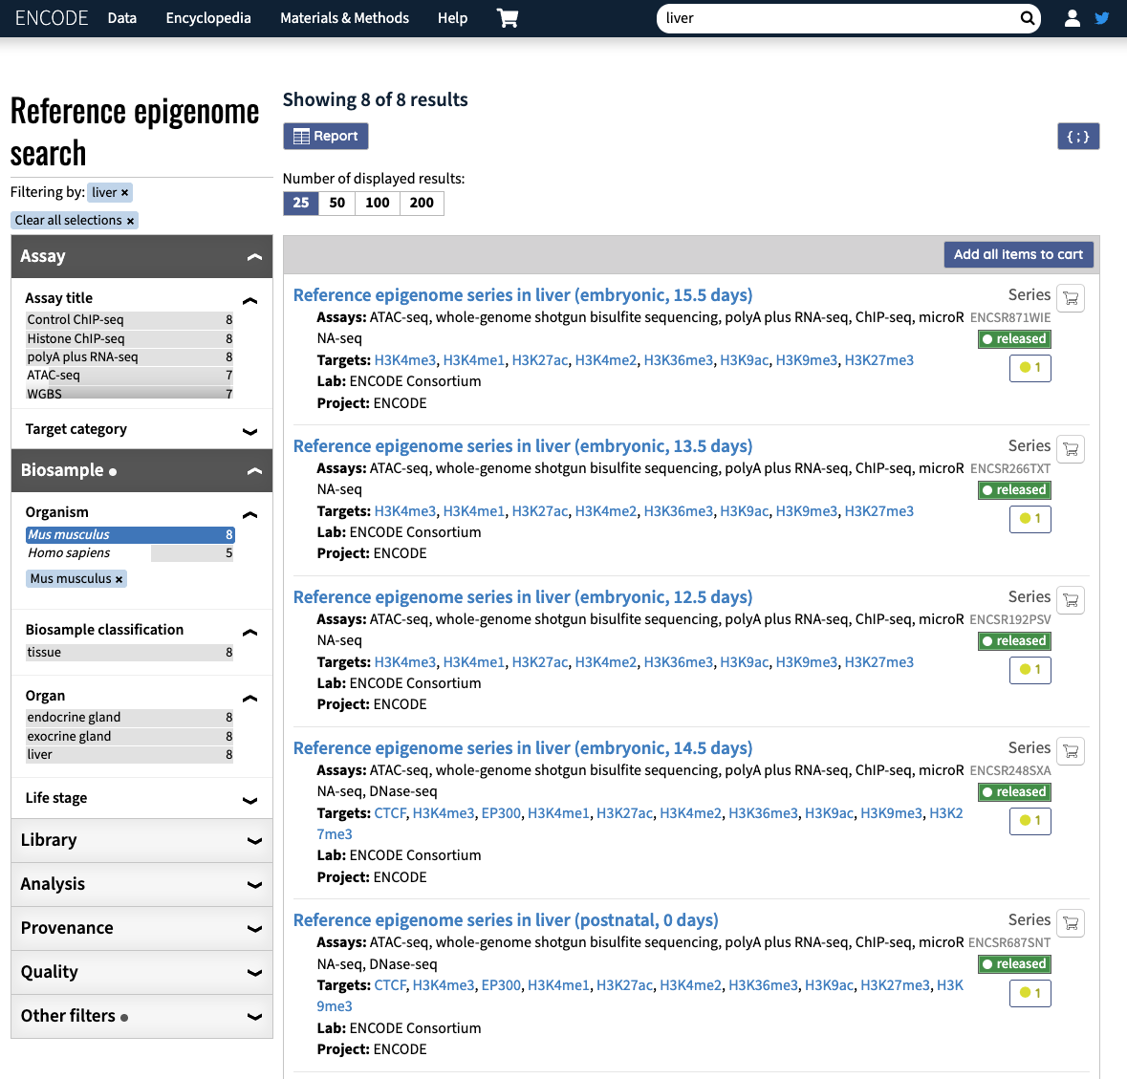
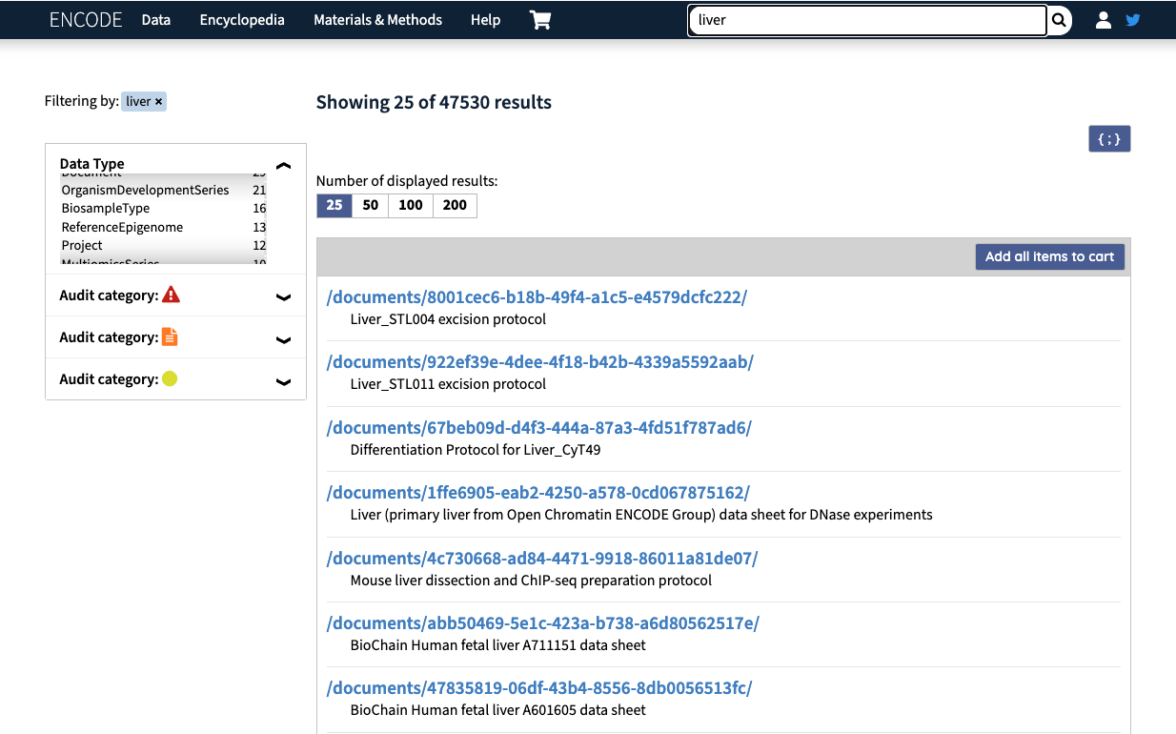
The ENCODE Reference Epigenomes

Slide 18
Do not edit
How to change the design
Which of these statements are true about ENCODE?
Presenting with animations, GIFs or speaker notes? Enable our Chrome extension
Notes:
📣 This is Slido interaction slide, please don't delete it. ✅ Click on 'Present with Slido' and the poll will launch automatically when you get to this slide.

Slide 19
Questions?

Slide 20
Hands-on

Slide 21

Do not edit
How to change the design
How many DNase-seq experiments from female human cerebellum tissue donors are available?
Presenting with animations, GIFs or speaker notes? Enable our Chrome extension
Notes:
1- 24 https://www.encodeproject.org/search/?type=Experiment&control_type!=*&status=released&perturbed=false&biosample_ontology.classification=tissue&assay_title=DNase-seq&replicates.library.biosample.donor.organism.scientific_name=Homo+sapiens&biosample_ontology.term_name=cerebellum&replicates.library.biosample.sex=female
📣 This is Slido interaction slide, please don't delete it. ✅ Click on 'Present with Slido' and the poll will launch automatically when you get to this slide.

Slide 22
Do not edit
How to change the design
How many reference epigenomes for human hepatocytes are available?
Presenting with animations, GIFs or speaker notes? Enable our Chrome extension
Notes:
2- 1 https://www.encodeproject.org/search/?type=Experiment&control_type!=*&related_series.@type=ReferenceEpigenome&replicates.library.biosample.donor.organism.scientific_name=Homo+sapiens&status=released&biosample_ontology.classification=in+vitro+differentiated+cells&biosample_ontology.term_name=hepatocyte
📣 This is Slido interaction slide, please don't delete it. ✅ Click on 'Present with Slido' and the poll will launch automatically when you get to this slide.

Slide 23
Do not edit
How to change the design
How many ENCODE experiments are linked to forebrain E13.5?
Presenting with animations, GIFs or speaker notes? Enable our Chrome extension
Notes:
12: https://www.encodeproject.org/reference-epigenomes/ENCSR654ORD/
📣 This is Slido interaction slide, please don't delete it. ✅ Click on 'Present with Slido' and the poll will launch automatically when you get to this slide.

Slide 24
Do not edit
How to change the design
Are there any open chromatin experiments available that are linked to forebrain E13.5?
Presenting with animations, GIFs or speaker notes? Enable our Chrome extension
Notes:
yes ATAC-seq and DNase-seq:: https://www.encodeproject.org/reference-epigenomes/ENCSR654ORD/
📣 This is Slido interaction slide, please don't delete it. ✅ Click on 'Present with Slido' and the poll will launch automatically when you get to this slide.

Slide 25
2
ENCODE cCREs and SCREEN

Slide 26
The ENCODE Registry of cCREs and SCREEN
Figure extracted from Expanded encyclopaedias of DNA elements in the human and mouse genomes¹
¹The ENCODE Project Consortium., Moore, J.E., Purcaro, M.J. et al. Expanded encyclopaedias of DNA elements in the human and mouse genomes. Nature 583, 699–710 (2020). https://doi.org/10.1038/s41586-020-2493-4

Slide 27
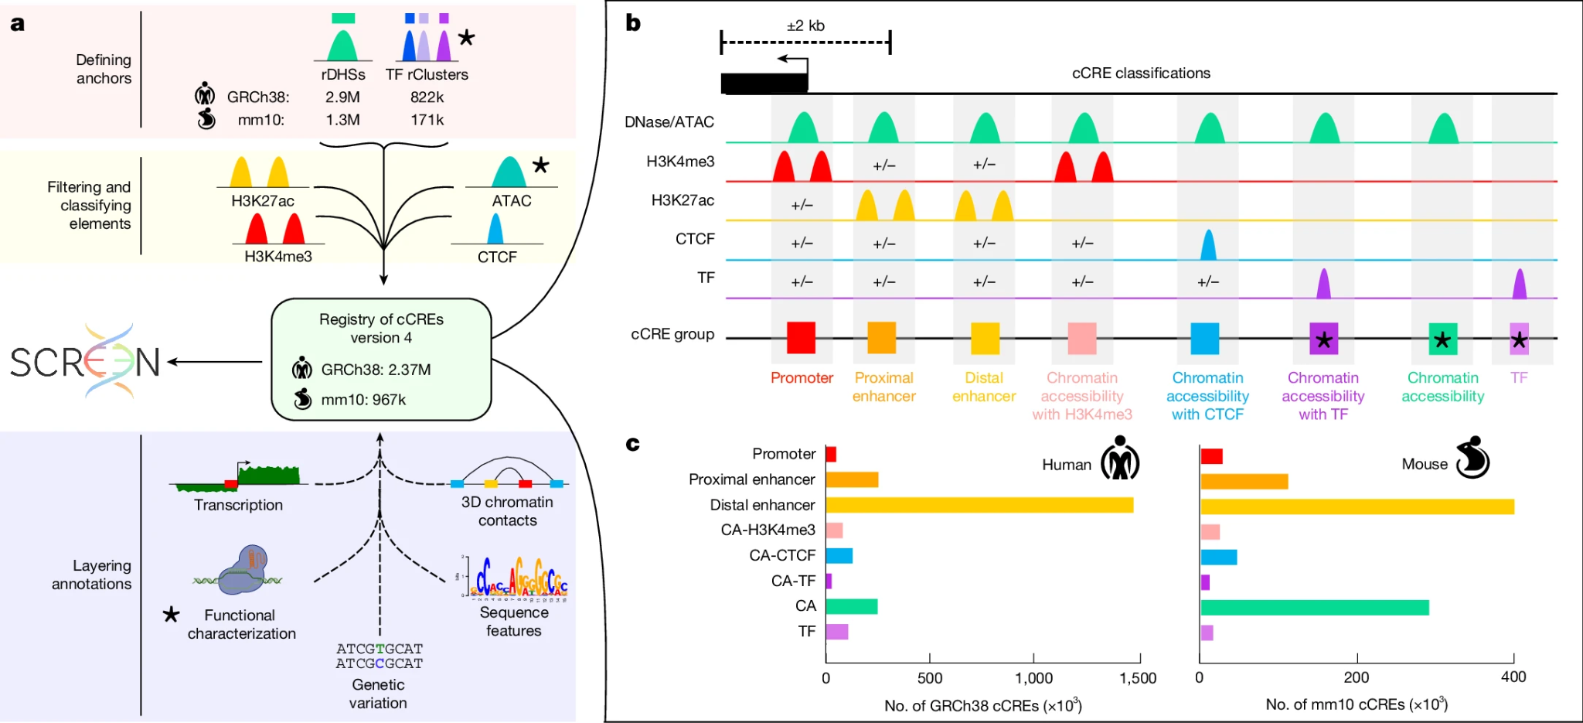
The ENCODE Registry of cCREs
A candidate cis-regulatory element is a genomic interval with ENCODE biochemical evidence for regulatory activity.
The registry gives each interval a stable coordinate, cell-type agnostic class, and evidence trail.
Context-aware: one registry element can have different activity calls across biosamples.
Figure extracted from Expanded encyclopaedias of DNA elements in the human and mouse genomes³
³Moore, J.E., Pratt, H.E., Fan, K. et al. An expanded registry of candidate cis-regulatory elements. Nature (2026). https://doi.org/10.1038/s41586-025-09909-9

Slide 28
The ENCODE Registry of cCREs
cCREs are anchored by using complementary strategies:
Representative DNase hypersensitivity sites (rDHSs): Cluster DNase-seq peaks across biosamples.
Reproducible TF binding (TF rClusters): Recover protein-binding sites that may lack strong accessibility.
Multi-mapper rDHSs: Improve coverage in duplicated and repetitive regions
Figure extracted from Expanded encyclopaedias of DNA elements in the human and mouse genomes³
³Moore, J.E., Pratt, H.E., Fan, K. et al. An expanded registry of candidate cis-regulatory elements. Nature (2026). https://doi.org/10.1038/s41586-025-09909-9

Slide 29
The ENCODE Registry of cCREs
cCREs are classified based on epigenomic evidence across surveyed biosamples:
Promoter-like cCREs: Near a TSSs with high chromatin accessibility (CA) and H3K4me3 signal.
Enhancer-like cCREs: Accessible elements with high H3K27ac signal, subdivided into TSS-proximal and TSS-distal enhancers.
Chromatin accessibility + H3K4me3 (CA–H3K4me3) cCREs: Accessible elements with H3K4me3 but lacking strong H3K27ac and located away from TSSs.
Chromatin accessibility + CTCF (CA–CTCF) cCREs: Accessible elements with strong CTCF binding and low histone acetylation.
Chromatin accessibility + transcription factor (CA–TF) cCREs: Accessible elements overlapping transcription factor clusters but lacking strong histone modification signals.ster.
Chromatin accessibility (CA) cCREs: Accessible elements lacking strong H3K4me3, H3K27ac, or CTCF signals.
Transcription factor (TF) cCREs: TF binding in the absence of detectable chromatin accessibility or histone modification signals.
Figure extracted from Expanded encyclopaedias of DNA elements in the human and mouse genomes³
³Moore, J.E., Pratt, H.E., Fan, K. et al. An expanded registry of candidate cis-regulatory elements. Nature (2026). https://doi.org/10.1038/s41586-025-09909-9

Slide 30
The ENCODE Registry of cCREs
cCREs are anchored by using complementary strategies:
Representative DNase hypersensitivity sites (rDHSs): Cluster DNase-seq peaks across biosamples.
Reproducible TF binding (TF rClusters): Recover protein-binding sites that may lack strong accessibility.
Multi-mapper rDHSs: Improve coverage in duplicated and repetitive regions
Figure extracted from Expanded encyclopaedias of DNA elements in the human and mouse genomes³
³Moore, J.E., Pratt, H.E., Fan, K. et al. An expanded registry of candidate cis-regulatory elements. Nature (2026). https://doi.org/10.1038/s41586-025-09909-9

Slide 31
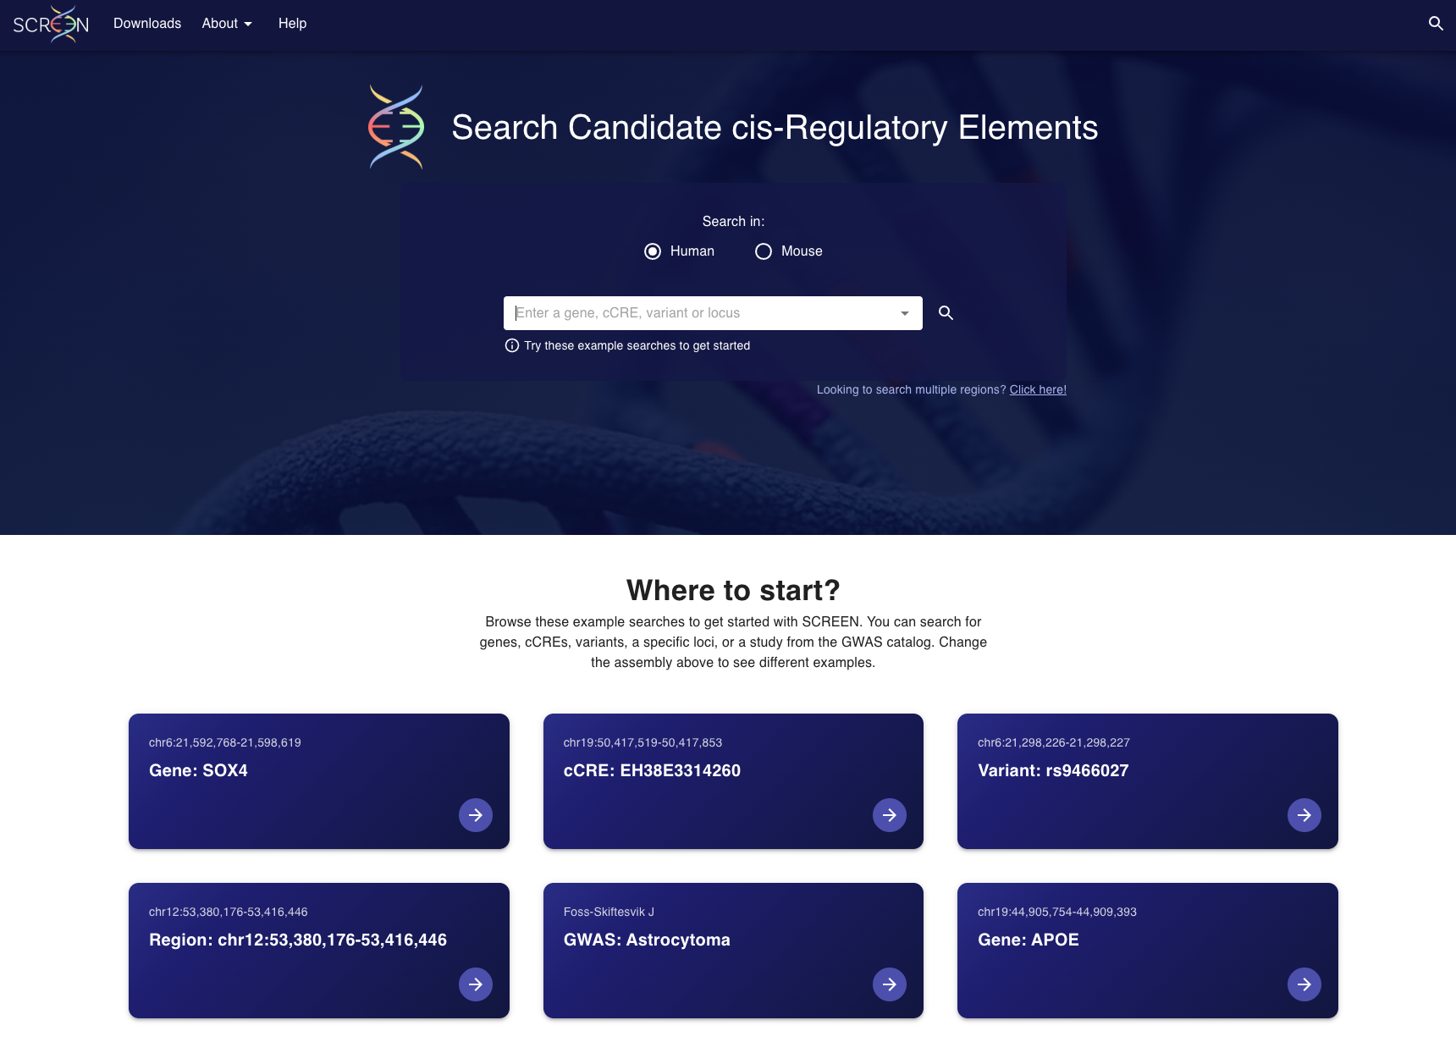

SCREEN
Web-based visualization and discovery platform for exploring the ENCODE Registry cCREs and other ENCODE Encyclopedia annotations.
Enables users to query, visualize, and download regulatory annotations across hundreds of human and mouse cell and tissue types
Turns the catalog into analysis: Examine cCREs relationships to genes, TF binding, chromatin state, and three-dimensional genome organization.

Slide 32
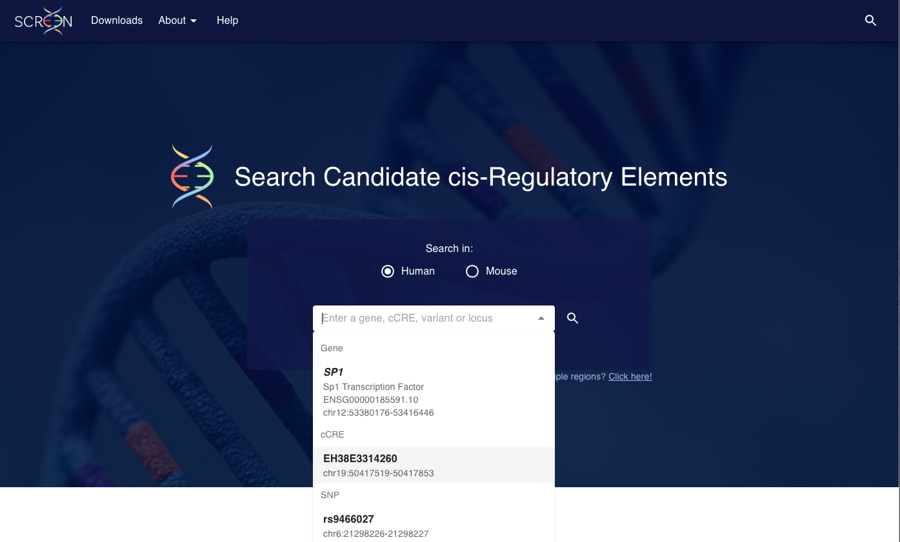
Accessing cCREs: SCREEN browser

Slide 33

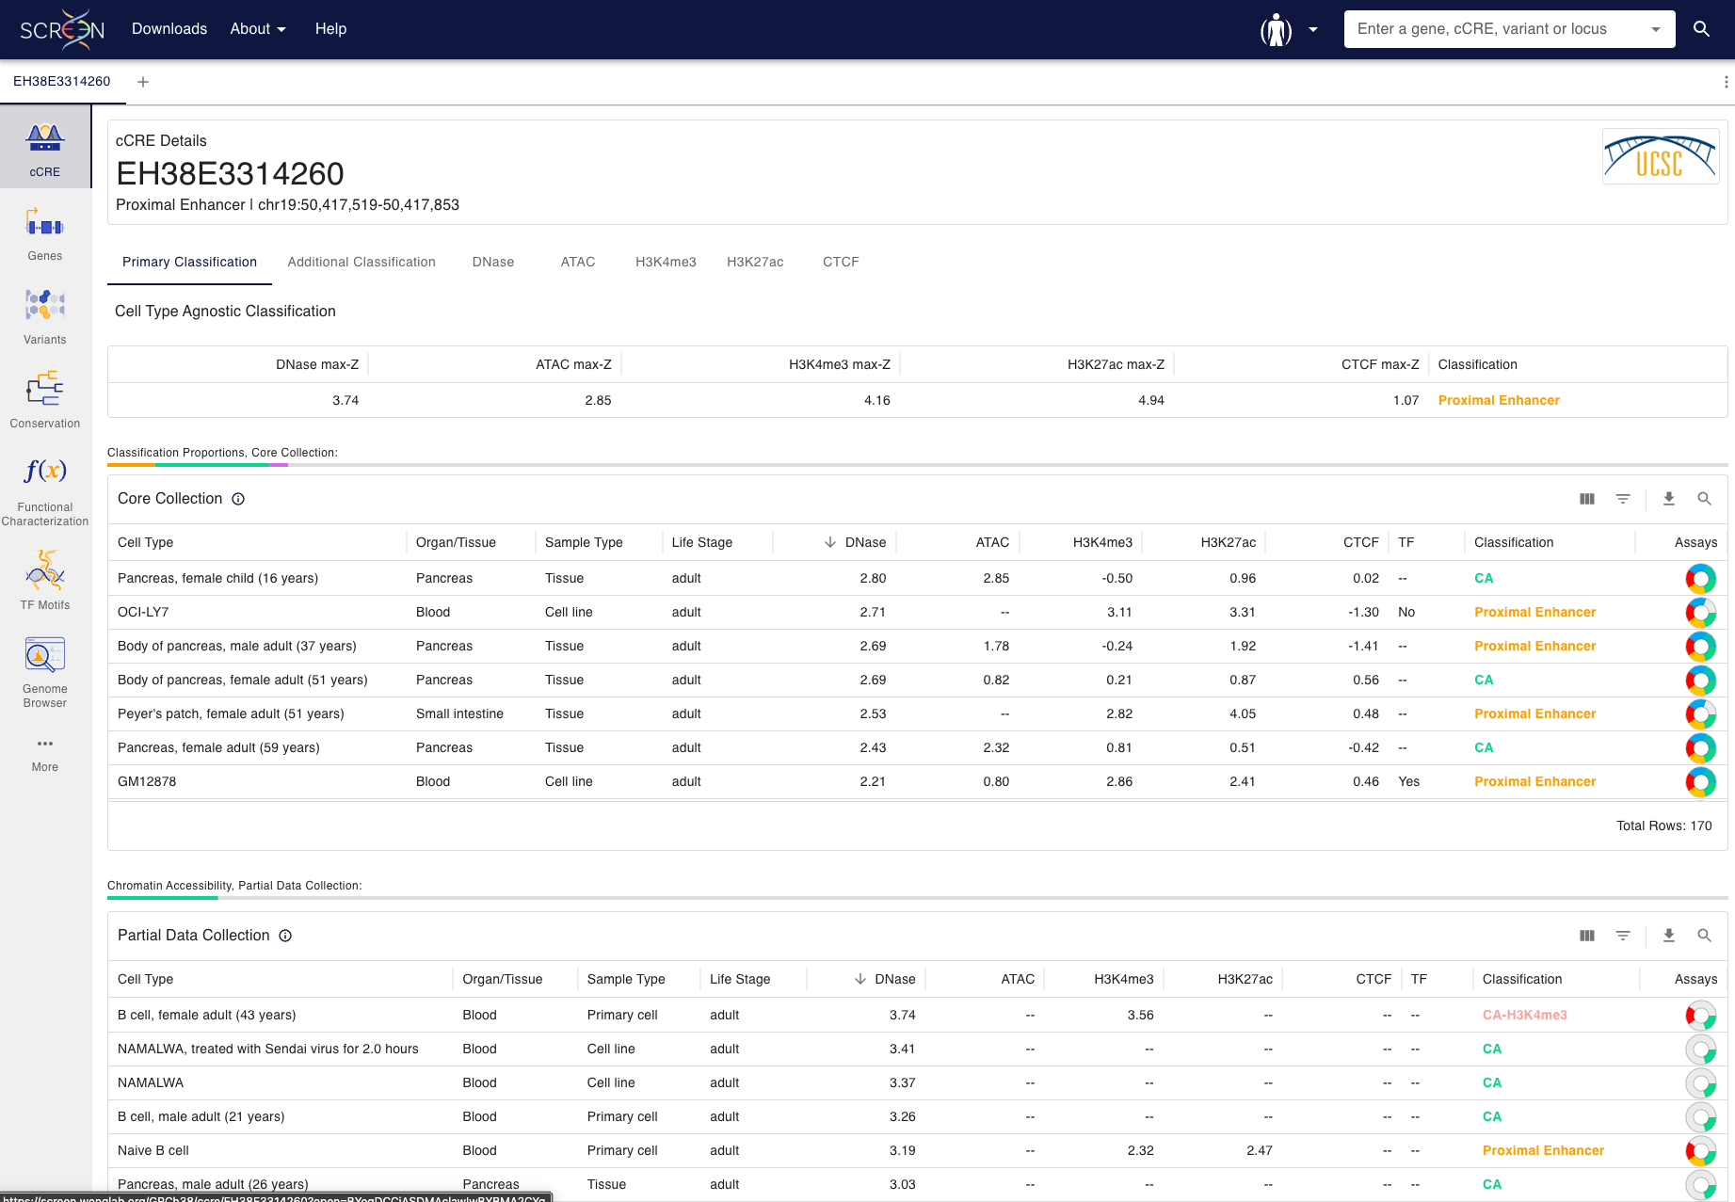
Accessing cCREs: SCREEN browser

Slide 34
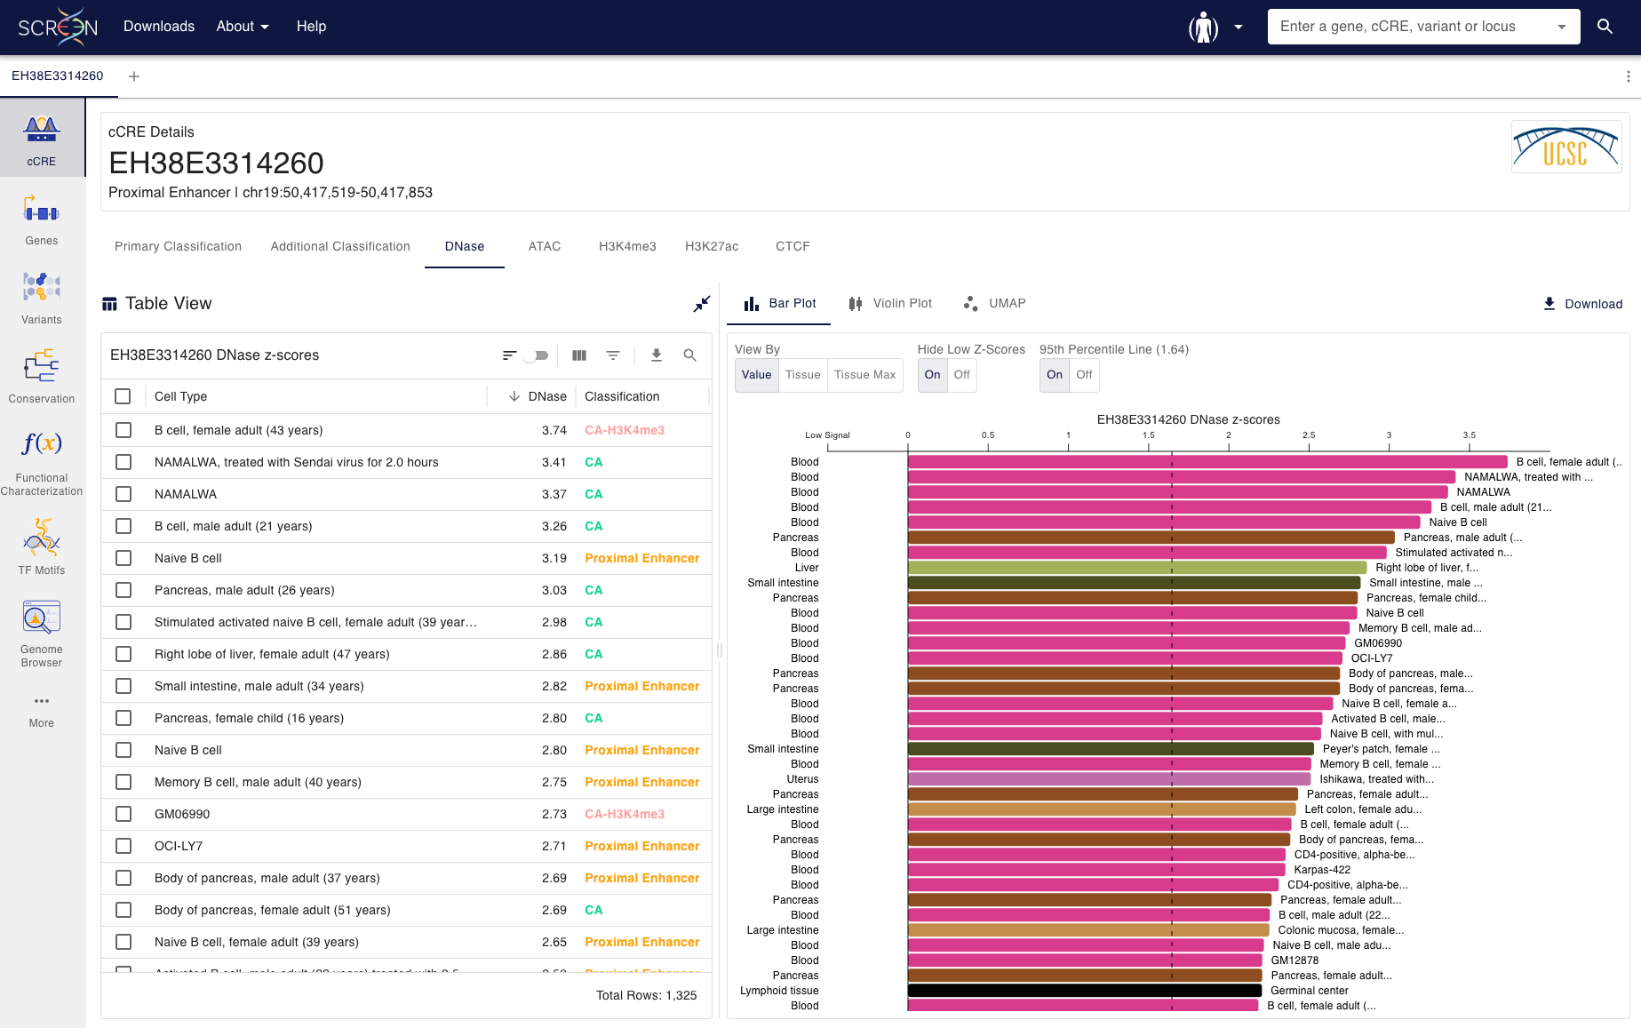
Accessing cCREs: SCREEN browser

Slide 35
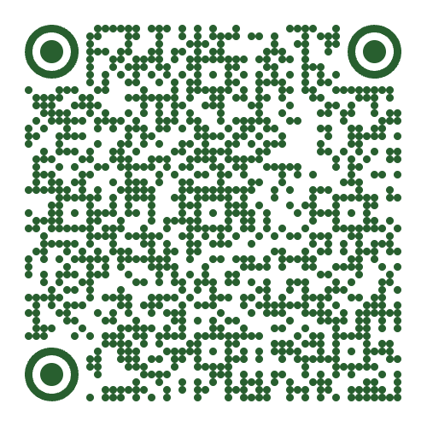
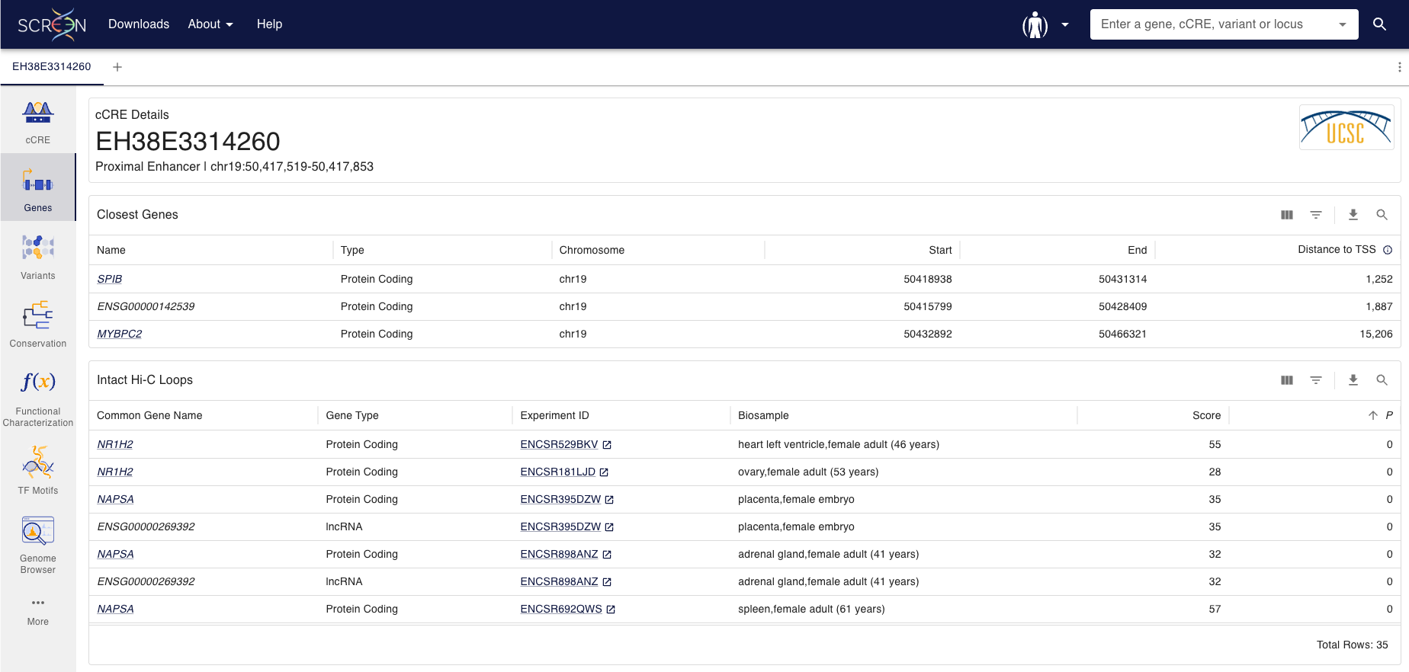
Accessing cCREs: SCREEN browser

Slide 36
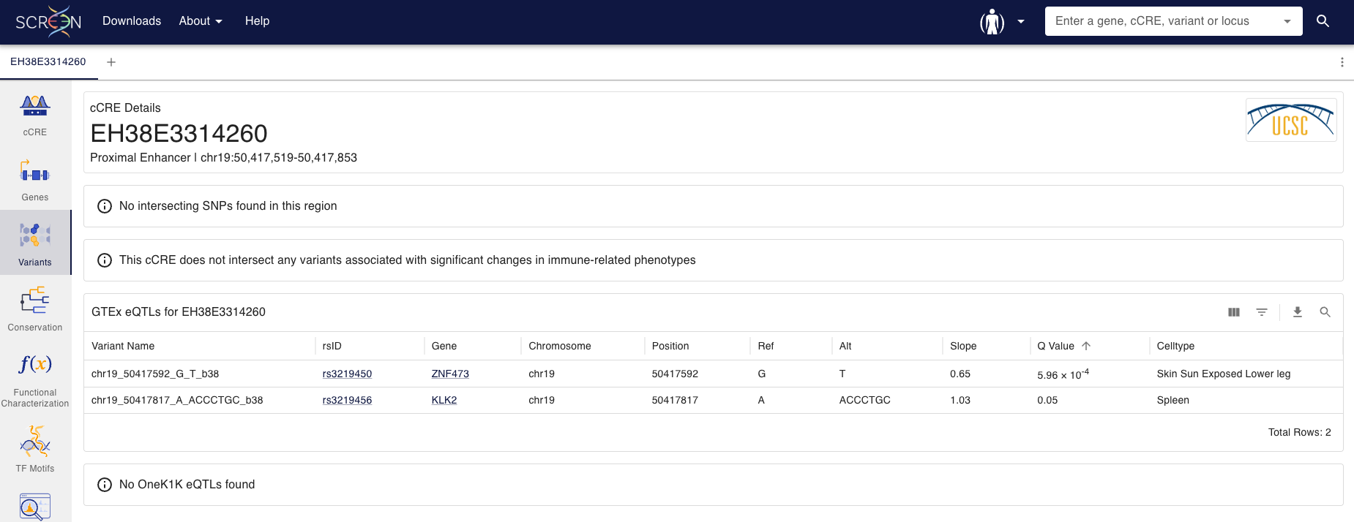
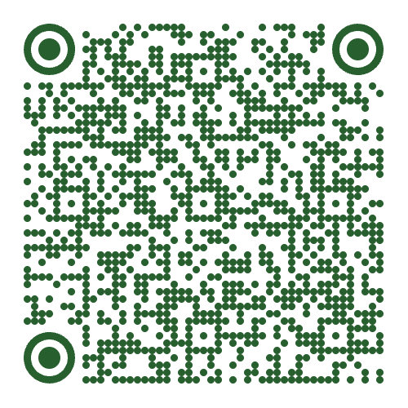
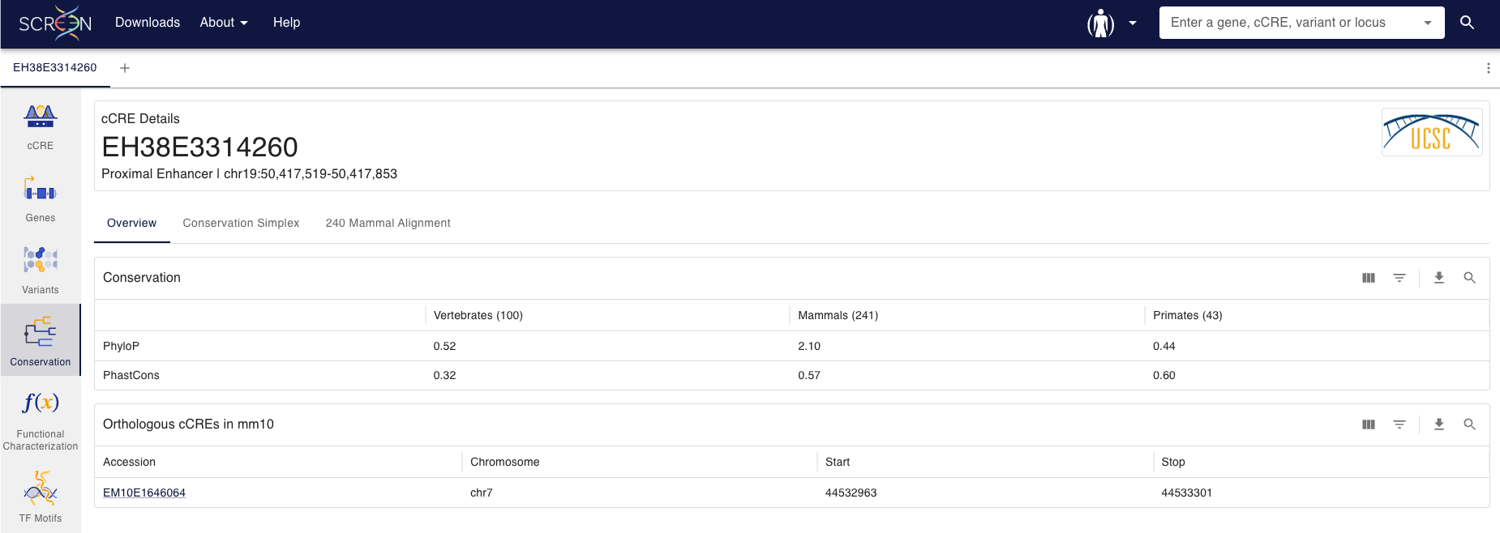

Accessing cCREs: SCREEN browser

Slide 37
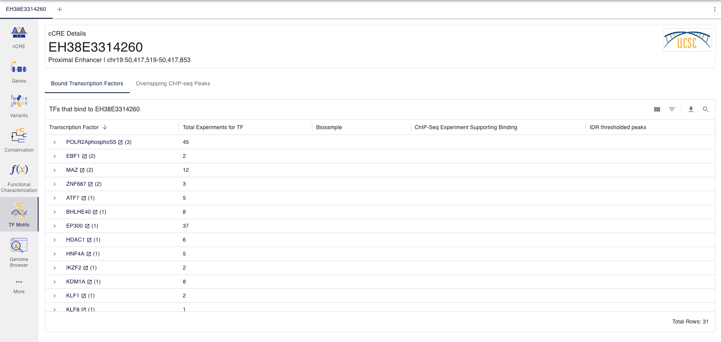
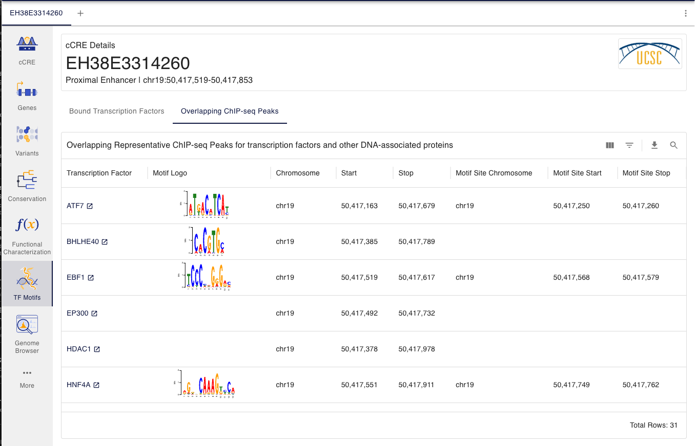

Accessing cCREs: SCREEN browser

Slide 38

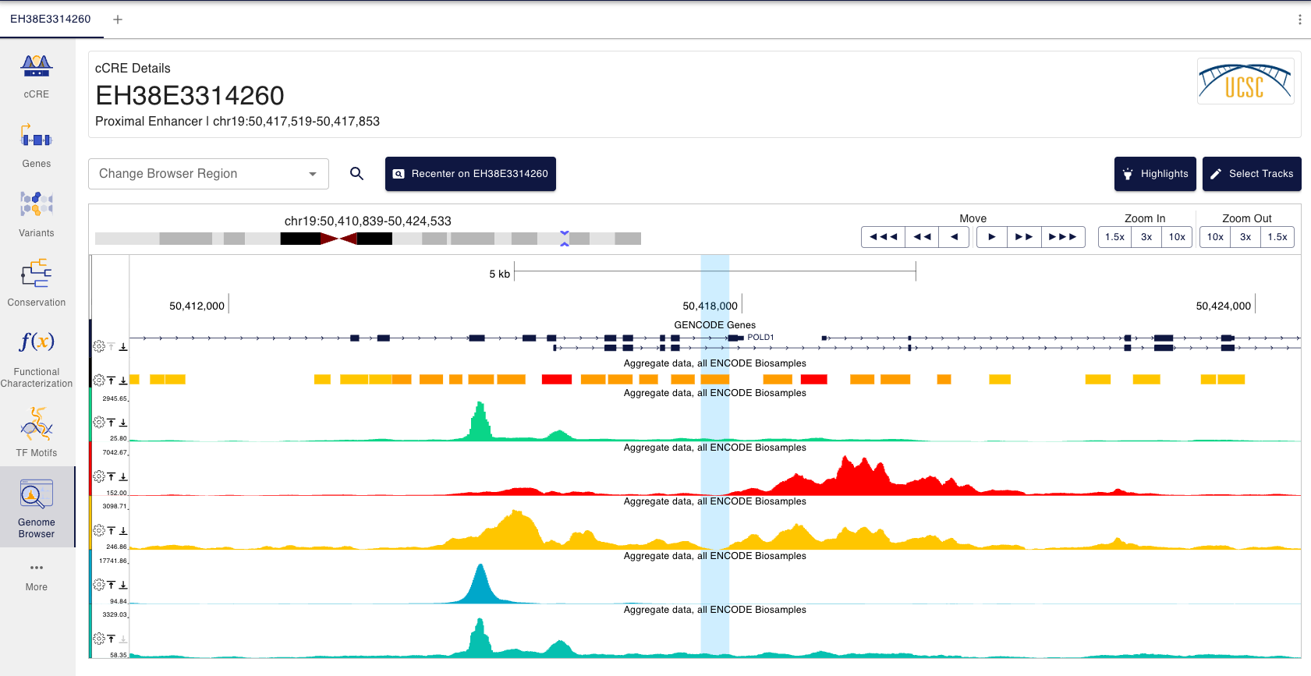
Accessing cCREs: SCREEN browser

Slide 39
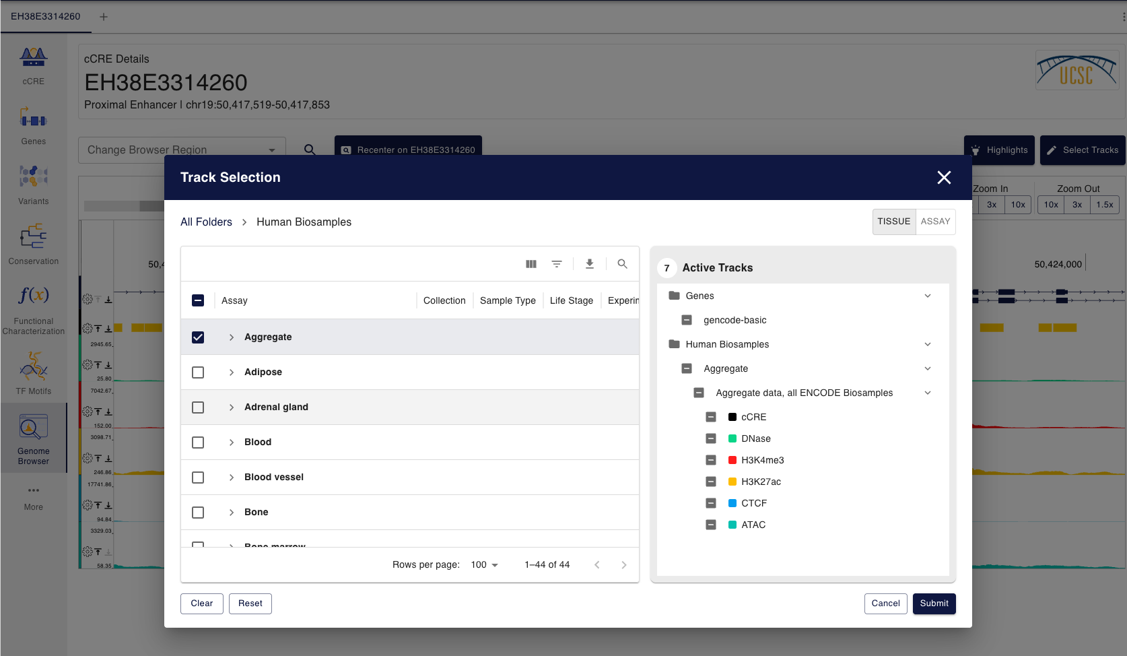
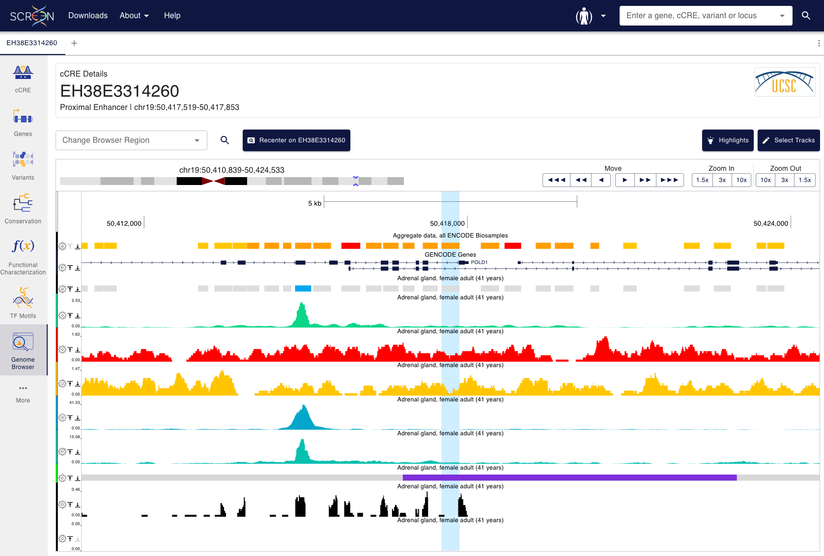
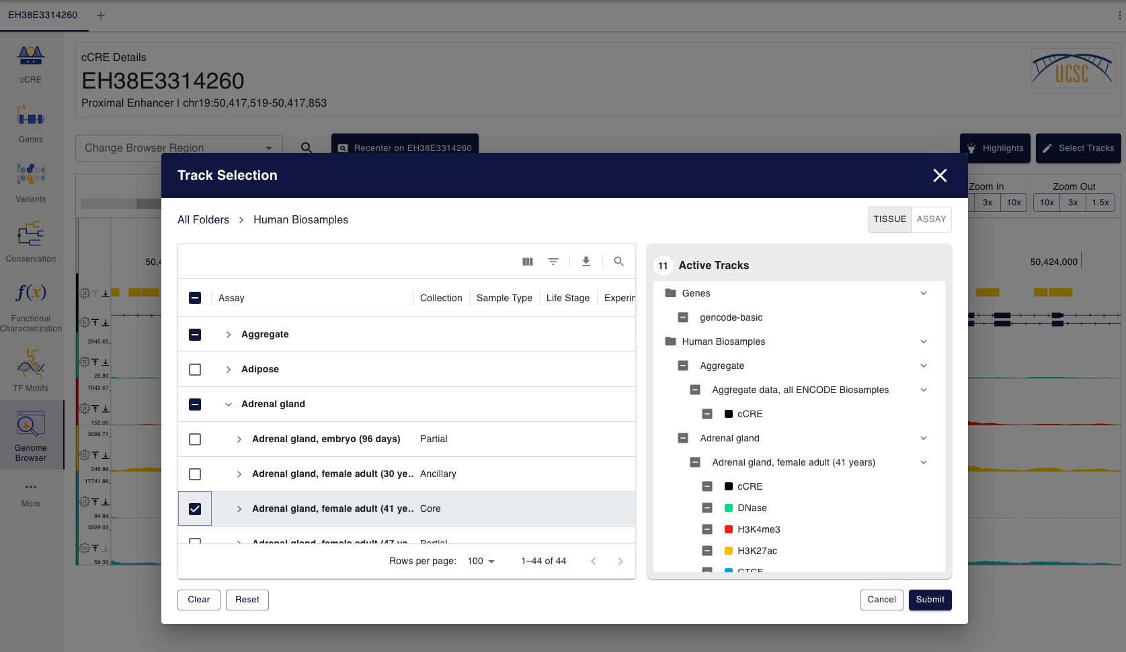
Accessing cCREs: SCREEN browser

Slide 40

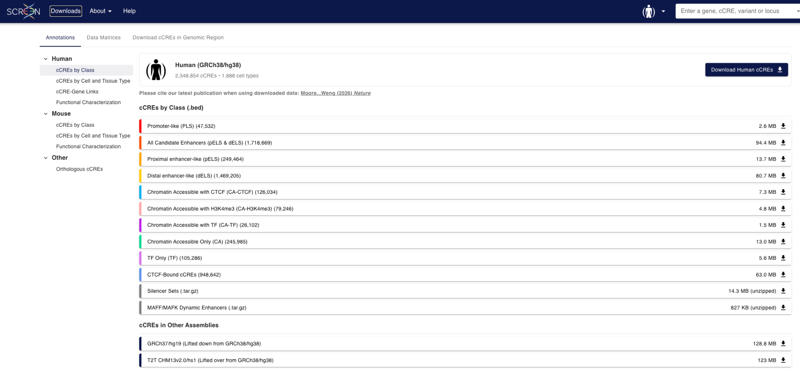
Accessing cCREs: SCREEN Downloads

Slide 41
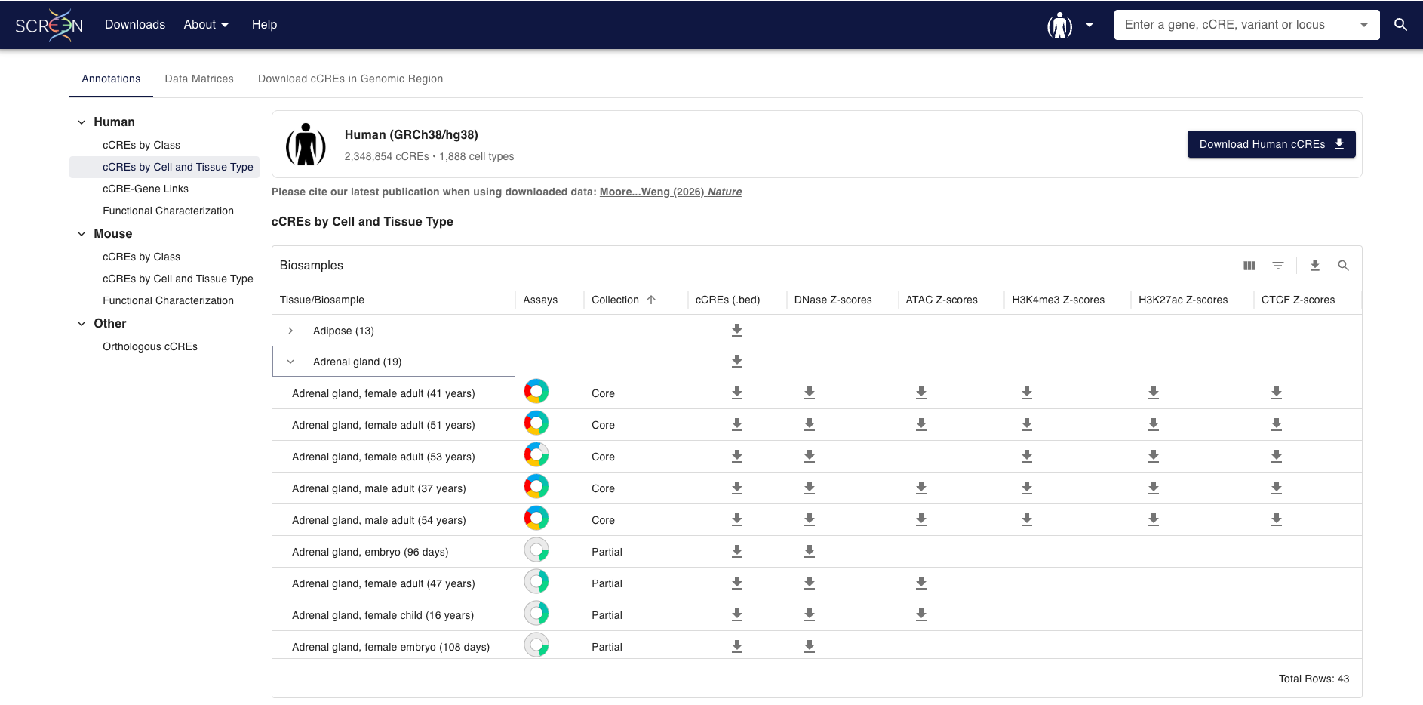
Accessing cCREs: SCREEN Downloads

Slide 42
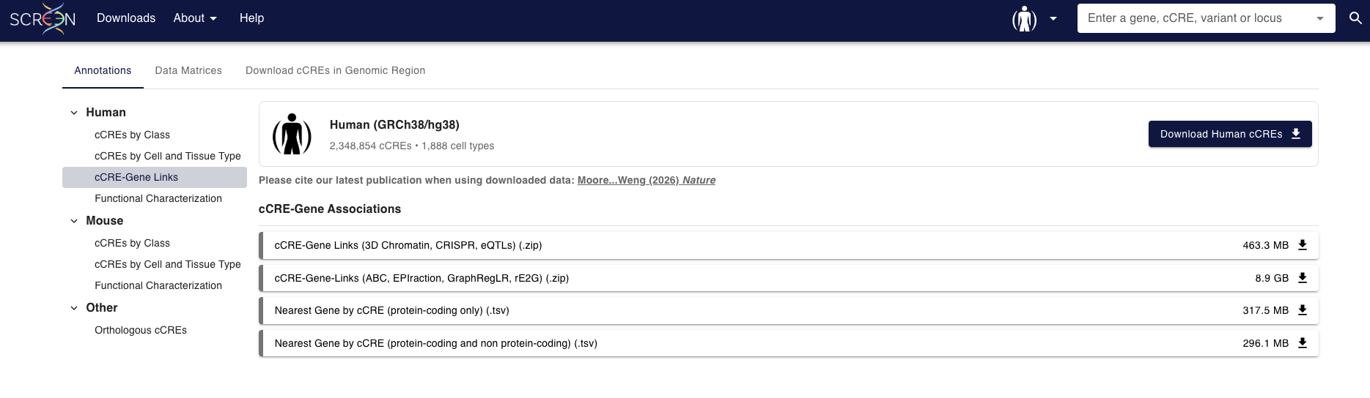
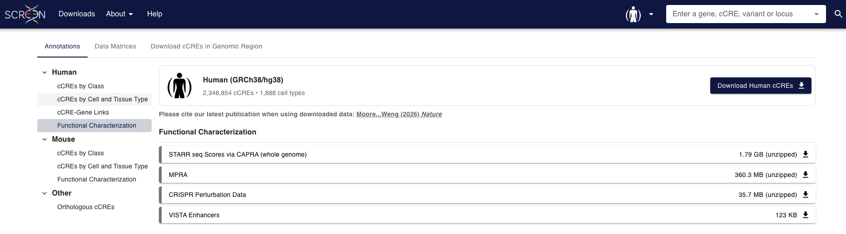
Accessing cCREs: SCREEN Downloads

Slide 43
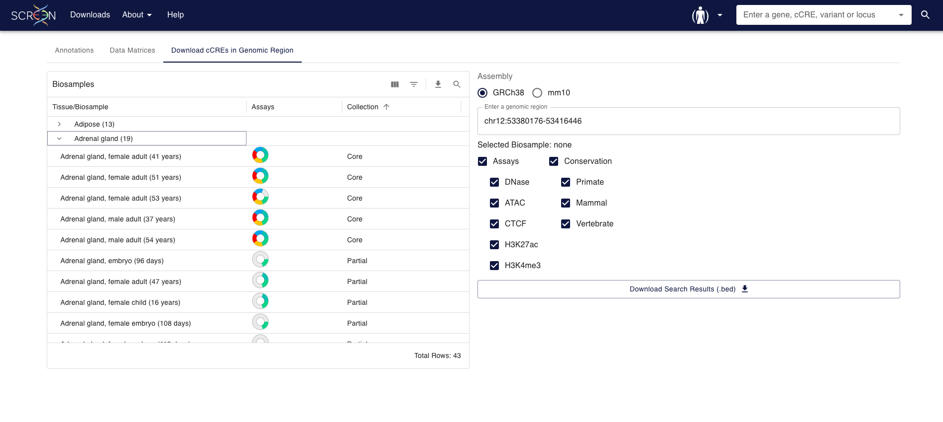
Accessing cCREs: SCREEN Downloads

Slide 44
Questions?

Slide 45
Hands-on

Slide 46
The ENCODE cCREs and SCREEN
Explore the indicated locus on SCREEN:
GRCh38, chr8:127,682,026-127,744,101
GRCm39/mm39, chr6:6,740,753-6,891,103; GRCm38/mm10 chr6:6,740,753-6,891,103
Inspect cCREs overlapping or near the indicated gene:
Human, MYC
Mouse, Dlx6
Review cCRE class, biosample support, and linked evidence for:
Human, HCT116 core collection
Mouse, Forebrain E13.5 ancillary collection

